Slide 1

Mood-based Music Generation Using GAN
CHARMI NAIK(21BCP283)
ANSH BHIMANI(21BCP297)
SHRESTY BOHRA(21BCP316)

Slide 2
Problem Statement
1
Limited Access to Personalized
Music Therapy
2
Disconnection and Alienation
Existing music recommendation systems fail to provide personalized, mood-based music experiences tailored to individual emotional states, hindering the therapeutic potential of music for mental health and well-being.
The lack of tailored musical experiences exacerbates feelings of disconnection and alienation among individuals, contributing to the prevalence of stress, anxiety, and depression in society.
3
Need for Innovative Solutions
4
Empowerment Through Technology
Addressing the societal need for personalized music experiences requires innovative solutions that leverage artificial intelligence and techniques to generate music compositions that authentically reflect and respond to users' emotional states.
By developing a mood-based music generation system, this project aims to empower individuals to access tailored musical experiences that foster emotional connection, comfort, and support, contributing to holistic mental health and well-being in society.

Slide 3

Introduction
In the dynamic landscape of artificial intelligence, the fusion of technology and creativity has led to groundbreaking innovations across various domains, including music composition. By leveraging GAN, we can generate bespoke musical compositions that evoke specific emotional moods, intertwining the art of music with the capabilities of AI and unlocking fresh avenues of creativity and expression for both composers and music enthusiasts.

Slide 4
TECHNOLOGY STACK
LIBROSA
TENSORFLOW
KERAS
SOUNDFILE
Librosa is a Python package for music and audio analysis. It is used for loading audio files, extracting features, and processing audio data.
TensorFlow is an open-source machine learning framework developed by Google. In this code, TensorFlow is used for building and training the GAN model.
Keras is a high-level neural networks API written in Python. In this code, it is used as part of TensorFlow for building and training deep learning models. Specifically, it provides the Sequential model API for building neural network architectures.
SoundFile is a Python library for reading and writing sound files. It provides an interface to various audio file formats

Slide 5
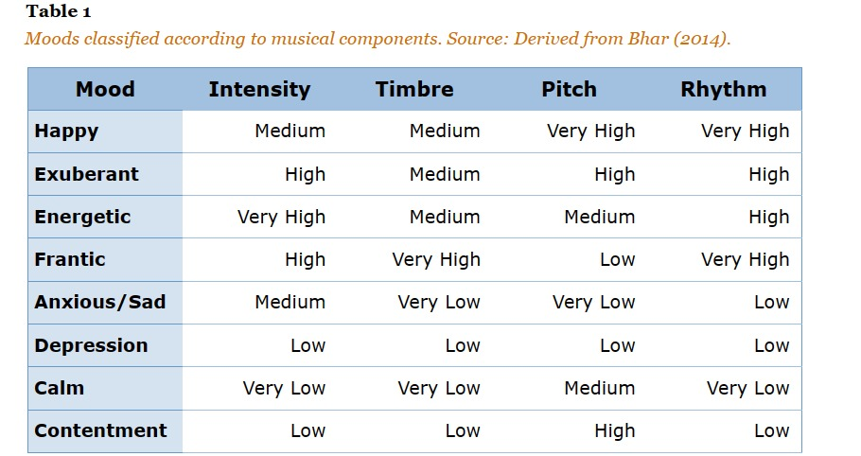
DATASET
The dataset is structured in the following way:
Moods:
a) Happy
b) Sad
c) Energetic
The system loads music files from the specified directory using Librosa's load() function. It then extracts the tempo and beat sequence using Librosa's beat_track() and onset_detect() functions, respectively.The system saves the extracted tempo and beat data to a CSV file. The CSV file contains the name of the song, the duration, the tempo, and the beat sequence.The system preprocesses the data by iterating through all the music files in the specified directory and saving the tempo and beat data to a CSV file.

Slide 6
TEMPO CLASSIFICATION
In most existing methods of music mood classification, the moods of songs are divided according to psychologist Robert Thayer’s traditional model of mood. The model divides songs along the lines of energy and stress, from happy to sad and calm to energetic. The classification is done based on tempo, with faster tempos associated with high-energy songs and slower tempos with lower-energy, sadder songs. The song’s tempo has a strong connection with the perceived energy level.
Acoustical Analysis:
When analyzing music, tempo, or the speed of the music, makes up a large part of quantifying the rhythm of a piece. Tempo can be identified through extracting a beat spectrum from the audio, then determining the frequency of the beats. Timbre, the tonal quality of a sound, is another crucial factor in mood classification. Harmonics give an instrument its unique sound, and the difference in timbre between two instruments playing the same note can be easily determined by analyzing their frequency responses over the note’s duration. Pitch, the frequency of a sound, is also a good indicator of a song's placement relative to the amount of stress in Thayer’s model. The intensity, or loudness of a song, is considered to be the average volume across its entirety.

Slide 7
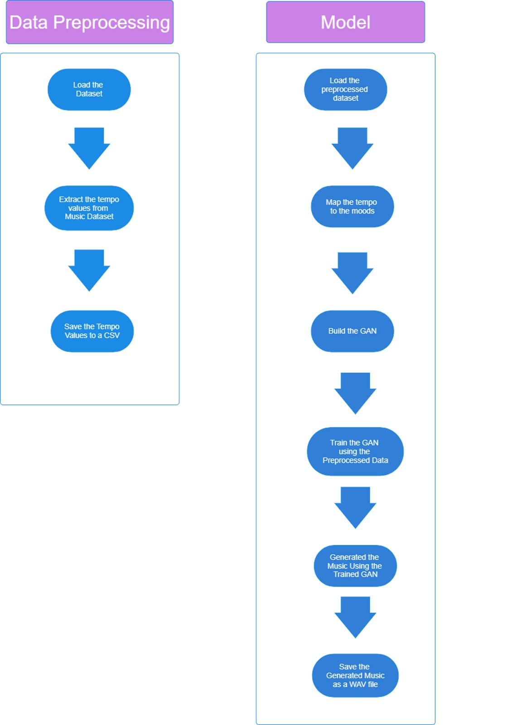
WORKFLOW

Slide 8
COMPARATIVE ANALYSIS
Aspects | Already existing models | Our Model
Architecture | LSTM-based architecture with sequential processing. | Feed-forward neural network architecture with parallel processing.
Activation Functions | LeakyReLU in both generator and discriminator. | ReLU and Tanh in the generator; ReLU and Sigmoid in the discriminator.
Loss Functions | Binary Crossentropy for both discriminator and generator. | Binary Crossentropy for both discriminator and generator.
Additional Features | No additional features were present in the model | Tempo-based mood classification. Tanh activation in the generator's output layer.
Mood-Based Guidance | The song generation had no inputs from user and took no consideration of user mood. | Music generation based on mood categories (Happy, Exuberant, Energetic, Frantic, Sad) from tempo data.

Slide 9




Future Scope
Innovative Mood
Recognition Techniques
Exploration of Style
Transfer in Music
Generation
Interactive User
Interfaces
Multi-modal Music Composition
Leveraging advanced methods like NLP and audio sentiment analysis to enhance mood recognition accuracy, thereby refining the generation of music tailored to specific emotional states.
Investigating methodologies to transfer musical styles across genres or from different artists, expanding the spectrum of customizable options available to users during music creation.
Integrating interactive features such as user feedback mechanisms and personalized music recommendations to foster greater engagement and satisfaction among users, enhancing the overall music generation experience.
Incorporating diverse modalities such as lyrics and instrumental tracks into the music generation process to create richer and more immersive compositions, enriching the listening experience for audiences.

Slide 10




Conclusion
Transformative Impact of AI in Music
AI methodologies have revolutionized music composition, reshaping traditional artistic processes.
Synergy of Sentiment Analysis and GANs
Combining sentiment analysis with Generative Adversarial Networks (GANs) enables a deeper exploration of music's emotional dimensions.
New Avenues for Exploration:
Integrating AI in music opens up new avenues for understanding the intricate relationship between music and human emotions, paving the way for groundbreaking discoveries.

